Slide 1
License Plate Recognition
Jiamin Jiang
Xiaobo Jin

Slide 2
Content：
1. Introduction
2. Project Objective and Aims
3. Project Budget and Schedule
4. Methodology
5. Experimental Results
6. Discussion
7. Future Works
8. Conclusion
2

Slide 3
Introduction
Intelligent transportation: ETC、 parking lot
Existing main technologies:
- Traditional technologies relying on OpenCV
- Two stage method of deep learning
- End to end integrated approach
3

Slide 4
Project Objective and Aims
Develop an efficient and accurate License Plate Recognition (LPR) system using OpenCV and SVM.
To implement this system, it is necessary to divide the system into the following modules:
Image Preprocessing
License Plate Location
Character Segmentation
Character Recognition
4

Slide 5
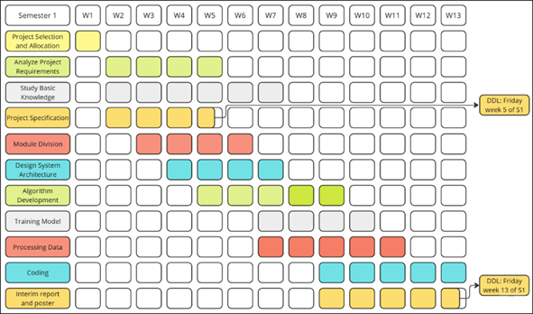
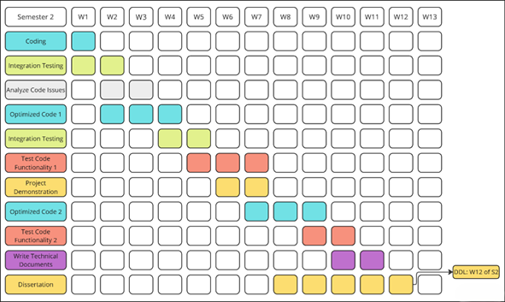
Project Budget and Schedule
Budget:
- Minimal computing resources
- No need for high-end GPUs
- Purchase PyCharm activation code
- Researching existing algorithms
Schedule Adjustments:
5

Slide 6
Methodology
1️⃣ Image Preprocessing
- Gaussian blurring
- Morphological operations
- Convert images to grayscale.
- Canny edge detection
2️⃣ License Plate Positioning
- Contour detection
- Color space analysis (HSV)
- Rotational correction
6

Slide 7
Methodology
3️⃣ Character Segmentation
- Histogram-based wave detection
- Peak detection
- Projection methods
4️⃣ Character Recognition
- SVM model
- HOG (Histogram of Oriented Gradients)
7

Slide 8
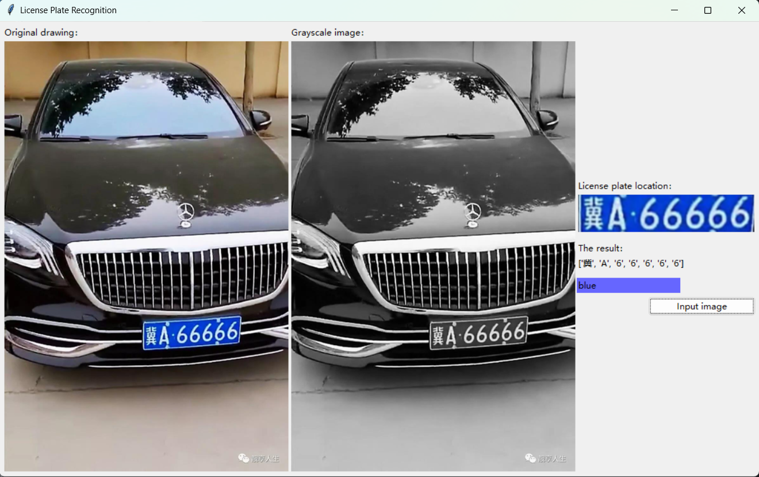
Experimental Results
Current Results:
- Locate license plates
- Split characters
- Character recognition
- Identify license plate color
8

Slide 9
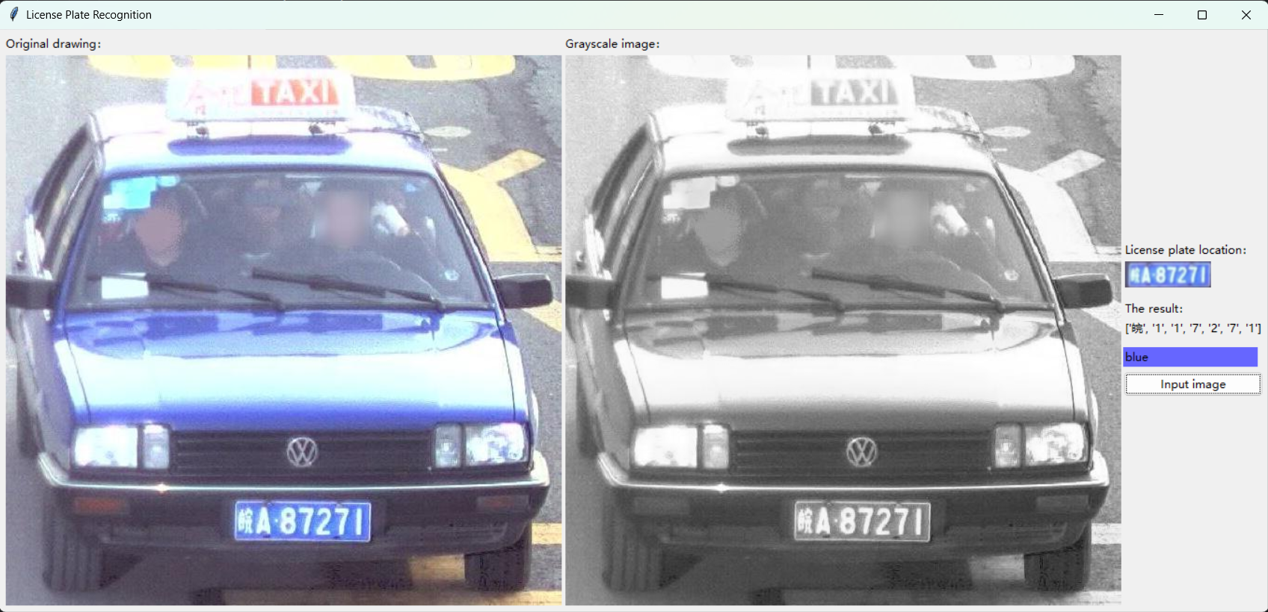
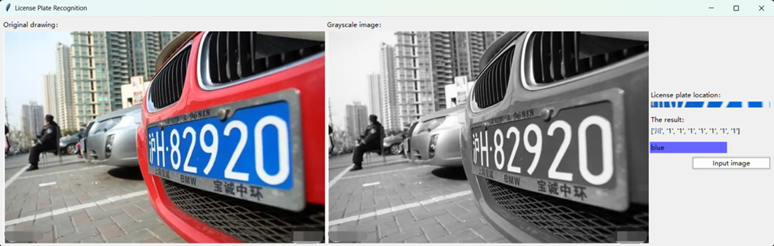
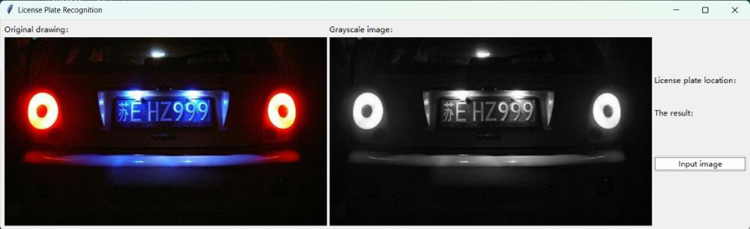
Experimental Results
Challenges Identified:
- Similar-looking characters
- The environment is too dark or bright
- Tilt shooting angle
9

Slide 10
Discussion
Pros of This Approach:
- Lightweight: low computational load, fast computing speed - low cost
- Easier to debug: Clear feature extraction
Limitations:
- Poor generalization ability: relying on manual parameter tuning
- Poor robustness complex environments: limited accuracy in character recognition in complex environments
10

Slide 11
Future Works
To improve the system:
- Upgrade license plate detection algorithm (YOLOv7 tiny, PP-YOLOE)
- Improve character recognition (CRNN, Transformer based model)
- Adopt an end-to-end model (YOLOv7+CNN)
11

Slide 12
Conclusion
Classic computer vision (OpenCV)
Machine learning (SVM + HOG features)
Lightweight & fast
Low computing needs
Best For
- Teaching demonstrations
- Simple applications
- Low-power devices
12

Slide 13
Thank You
Question?

